Slide 1
Digital Portfolio
STUDENT NAME : PRADA S
REGISTER NO AND NMID : 2426J1536
DEPARTMENT : BSC INFORMATION TECHNOLOGY
COLLEGE : KPR COLLEGE OF ARTS SCIENCE AND
RESEARCH

Slide 2
PROJECT TITLE
ONLINE VOTING SYSTEM

Slide 3


AGENDA
Problem Statement
Project Overview
End Users
Tools and Technologies
Portfolio design and Layout
Features and Functionality
Results and Screenshots
Conclusion
Github Link
3/21/2024 Annual Review

Slide 4

PROBLEM STATEMENT
Traditional voting methods require manual effort, are time-consuming, and may face issues like multiple voting, mismanagement, or lack of transparency. There is a need for a digital solution that makes voting secure, fast, and reliable

Slide 5

PROJECT OVERVIEW
The Online Voting System is a web/console application that allows registered users to log in and cast their votes digitally. Each user is allowed to vote only once, and the system automatically counts and stores the votes securely. At the end, results are displayed instantly.

Slide 6

WHO ARE THE END USERS?
Students (for college elections)
Organizations (for internal decision-making)
Clubs/Communities (for polls)
Government (as a prototype for e-voting)

Slide 7

TOOLS AND TECHNIQUES
Programming Language: Python (Tkinter/Flask) or C++
Database: MySQL / SQLite / File Storage
Frontend (if web): HTML, CSS, JavaScript
Version Control: GitHub

Slide 8
POTFOLIO DESIGN AND LAYOUT
User Login Page
Voting Page (candidate list with radio buttons/choices)
Confirmation Page (successful vote message)
Result Page (vote counts, winner displayed in chart)
8

Slide 9
FEATURES AND FUNCTIONALITY
Secure login system
One vote per user
Candidate list display
Vote counting and result generation
Admin access to manage candidates and view results
(Optional) Graphical results in charts

Slide 10
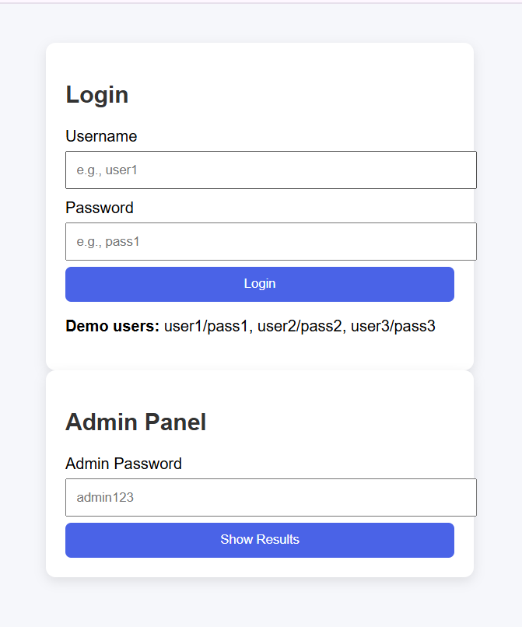

RESULTS AND SCREENSHOTS
1.User logs in with username & password.
2. Selects a candidate and submits vote.
3. Each user can vote only once.
4. Admin logs in to view results with counts & percentages.
3/21/2024 Annual Review
10

Slide 11
CONCLUSION
The Online Voting System provides a secure, reliable, and efficient way to conduct elections digitally. It reduces errors, prevents multiple voting, and saves time compared to manual voting methods.
GITHUB LINK:
https://prada19.github.io/PRADA36/
11

